Slide 1

NETWORK TOPOLOGY
STUDENT NAME : DINAYA MADHURYA
STUDENT NUMBER : CL/OTHMFL3/11/56

Slide 2
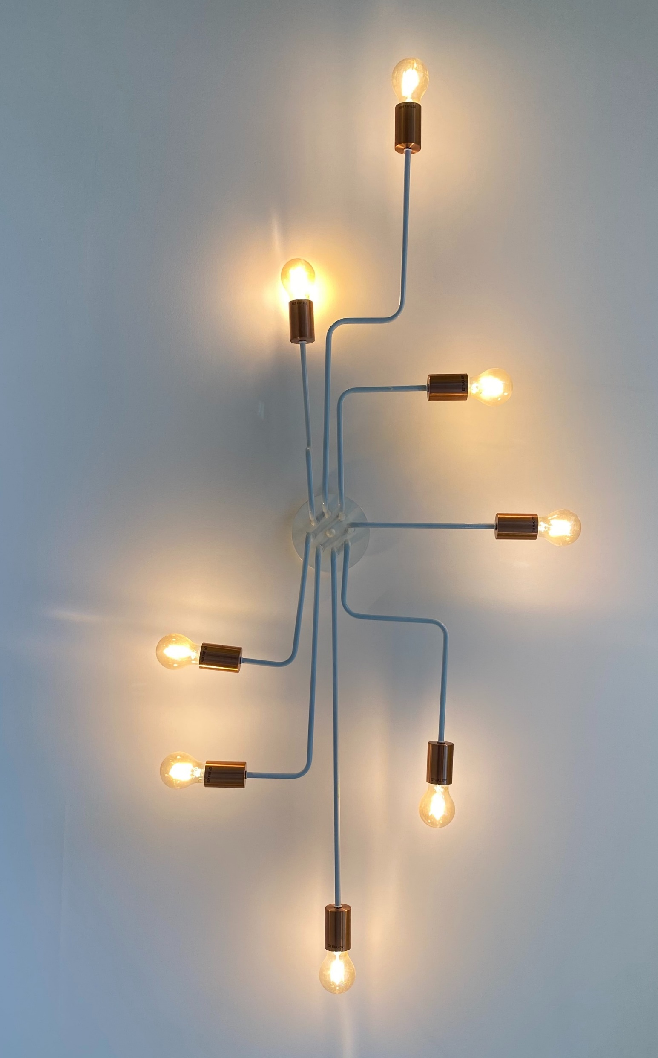
WHAT IS A NETWORK TOPOLOGY
A computer network is a collection of two or more computers which are connected together to share information and resources.
Network topology plays a major role in how a network functions. Namely, the topology has a direct effect on network functionality. Choosing the right topology can help increase performance, as a properly chosen and maintained network topology increases energy efficiency and data transfer rates.

Slide 3
TYPES OF TOPOLOGY
Based on geographical area covered
Based on Architecture
Local Area Network(LAN
Metropolitan Man Network(MAN)
Wide Area Network(WAN)
BUS TOPOLOGY
STAR TOPOLOGY
RING TOPOLOGY
MESH TOPOLOGY
TREE TOPOLOGY

Slide 4


WIDE ARE NETWORK
WANs extend over vast distances, connecting networks across cities, countries, or continents. WANs enable long-distance communication and connectivity on a global scale. The internet is an example of a WAN, connecting devices and networks worldwide.
LOCAL ARE NETWORK
LANs are for local connections in a confined area. LANs are used for connecting devices like computers, printers, and servers within a home, office, or campus to facilitate communication and resource sharing.
METROPOLITAN MAN AREA NETWORK
MANs cover a larger metropolitan region. MANs are designed to provide connectivity over a larger area than a LAN, making it possible for organizations or businesses in different parts of a city to communicate and share resources.

Slide 5
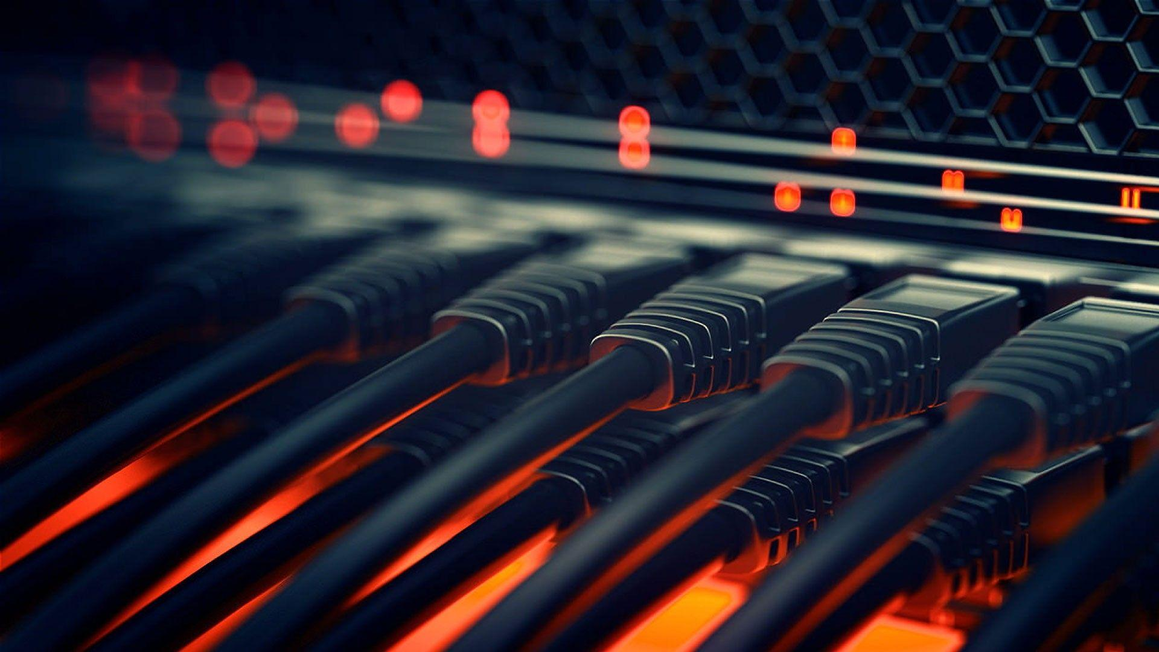
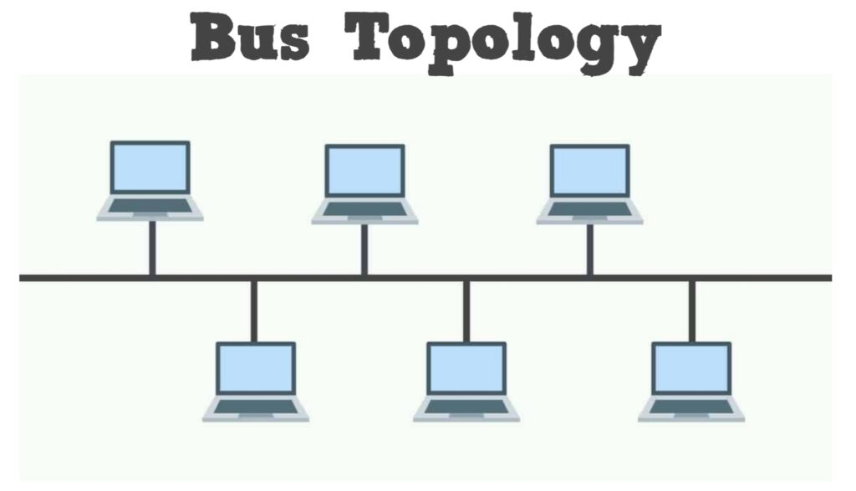
BUS TOPOLOGY
A Bus topology consists of a single cable called a bus connecting all nodes on a network without intervening connectivity devices
Advantages of Bus Topology
Works well for small networks.
Relatively inexpensive to implement.
Easy to expand joining two cables together.
Used in small network. Coaxial cable Network Card
Disadvantages of Bus Topology
Management costs can be high
Cables fails then whole network fails.
Cables has a limited length.

Slide 6

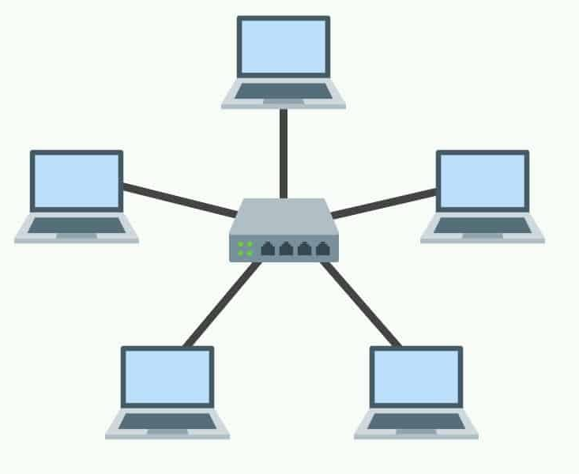
STAR TOPOLOGY
A star network is designed with each node (file server, workstation, peripheral) connected directly to a central network hub or server.
Advantages of Star Topology
Good option for modern networks
Low startup costs
Easy to manage
Offers opportunities for expansion
Most popular topology in use wide variety of equipment available
Disadvantages of Star Topology
Hub is a single point of failure
Requires more cable than the bus
Cost of installation is high.

Slide 7

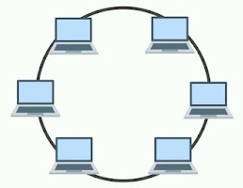
RING TOPOLOGY
A ring network is one where all workstations and other devices are connected in a continuous loop. There is no central server.
Advantages of Ring Topology
• Easier to manage; easier to locate a defective node or cable problem
• Well-suited for transmitting signals over long distances on a LAN
• Handles high-volume network traffic
Disadvantages of Ring Topology
• Expensive
• Requires more cable and network equipment at the start
• Not used as widely as bus topology – Fewer equipment options Fewer options for expansion to high-speed communication

Slide 8

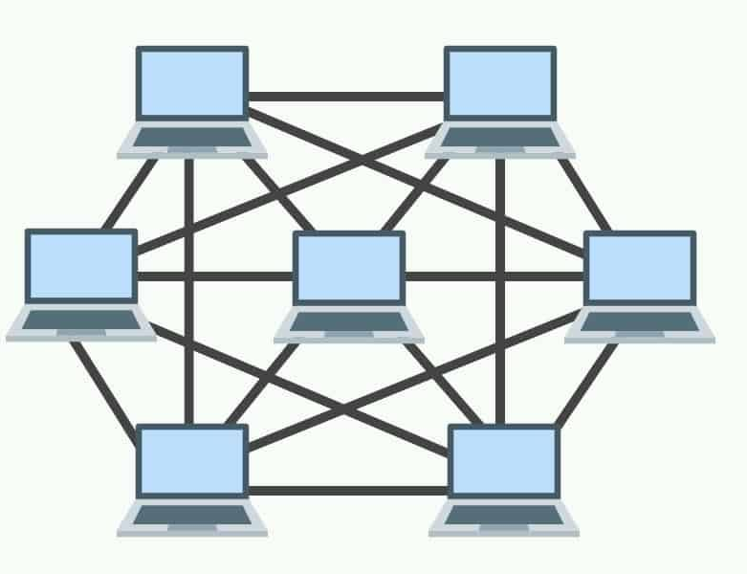
MESH TOPOLOGY
Mesh Topology It is a point-to-point connection to other nodes or devices. Traffic is carried only between two devices or nodes to which it is connected. Mesh has n(n-2)/2 physical channels to link devices.
Advantages Of Mesh Topology
• Each connection can carry its own data load.
• Fault is diagnosed easily.
• Provide security and privacy.
Disadvantage of mesh topology
• Installation and configuration is difficult.
• Cabling cost is more.
• Bulk wiring is required.

Slide 9
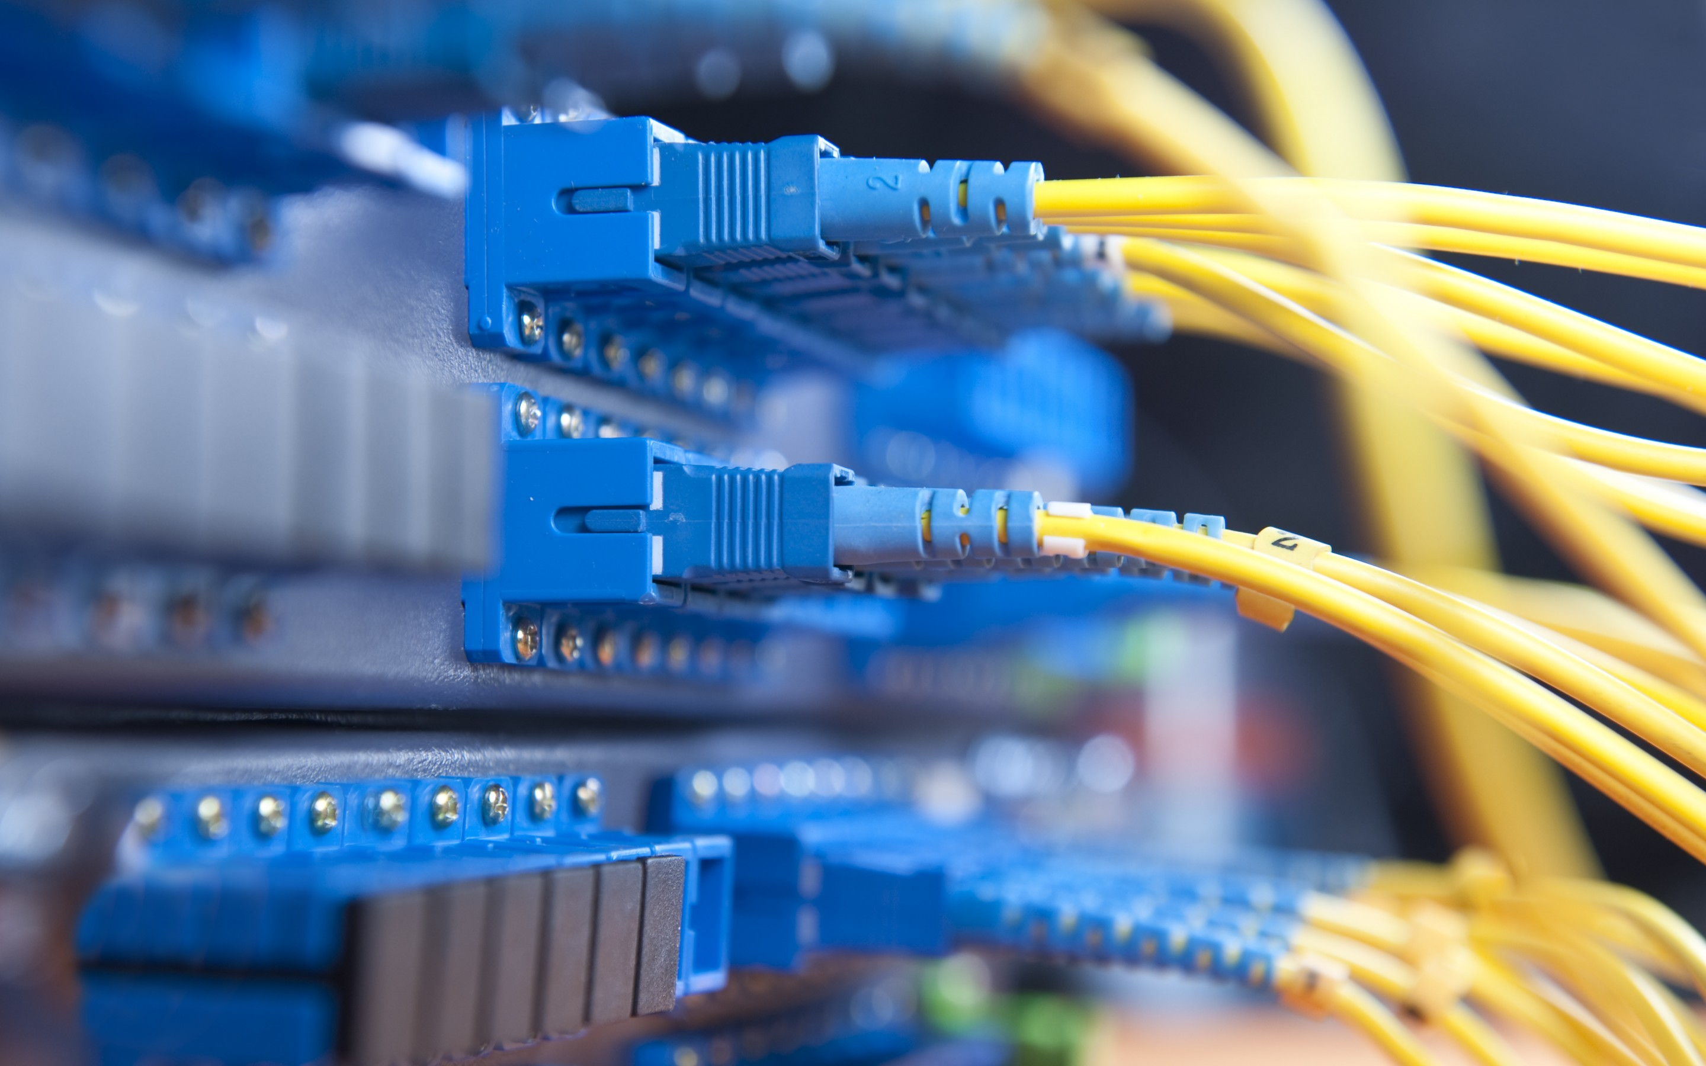
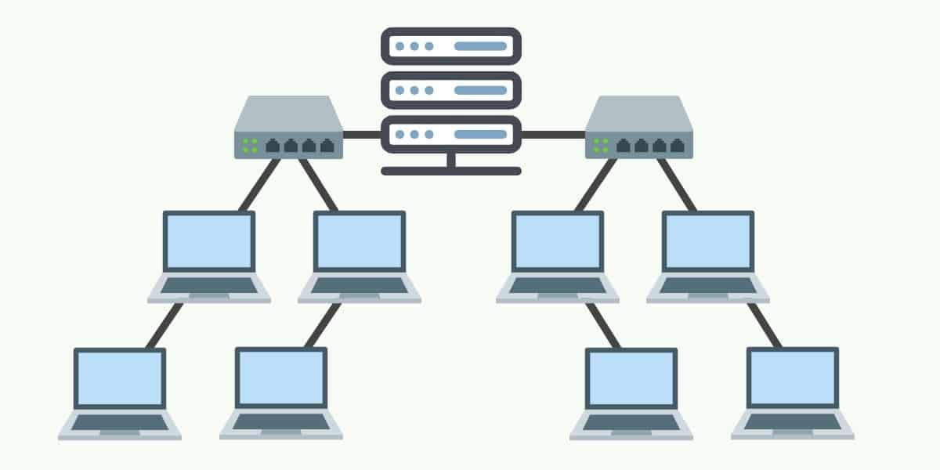
TREE TOPOLOGY
It has a root node and all other nodes are connected to it forming a hierarchy. It is also called Hierarchical Topology.
Advantages Of Tree Topology
• Extension of Bus and Star Topology.
• Expansion of nodes is possible and easy.
• Easily managed and maintained.
Disadvantages Of Tree Topology
• Heavily cabled.
• Costly.
• If more nodes are added maintenance is difficult.
• Central hub fails, network fails.

Slide 10


